Slide 1
Unit 4
Multiprotocol Supports

Slide 2
Introduction
Networking technology evolved along different paths, resulting in several different system to format data for transmission.
Suites of program were developed to comply with one system or another.
Program with multiple support can interact with many different underlying protocols.

Slide 3
Features
An Example of multiple protocol application is a messenger user interface that can represent many different underlying instant messenger services.
The program is written to be independent of the transport method or messenger format.
Run applications associated with one network protocol over different network protocols
connects matching applications across networks of different protocols through gateways

Slide 4
Function
Program with multiple protocol are written in two ways.
One is to keep the program generic so that it does not perform any processing, but merely displays the result of other system.
The other category of program, or protocols, with multiple protocol support is one written to be extended by additional programs. Web browser fall into this category

Slide 5
Protocol
There are protocols with multiple support.
The Point to Point Protocol has to interact with many different networking system.
It does this through a library of network control protocols, each one fitting a different network standard.

Slide 6
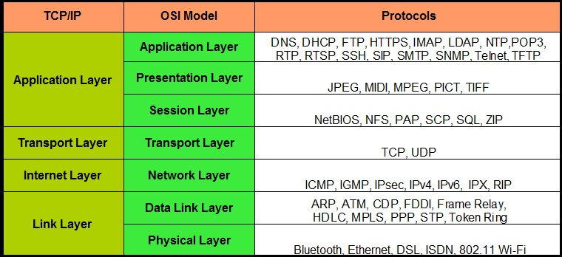
Protocol with Layers

Slide 7
